Slide 1

Final Year Project (End term)
2025

Slide 2
MUDDA
Supervisor (s): Dr. Shilpa Mahajan
Saumil Kulshreshtha (22CSU158)
Shivesh Kumar Dhiman (22CSU164)
Shubh Pundir (22CSU165)
Vikas Kumar (22CSU190)
SOET: CSE 2022 - 2026

Slide 3
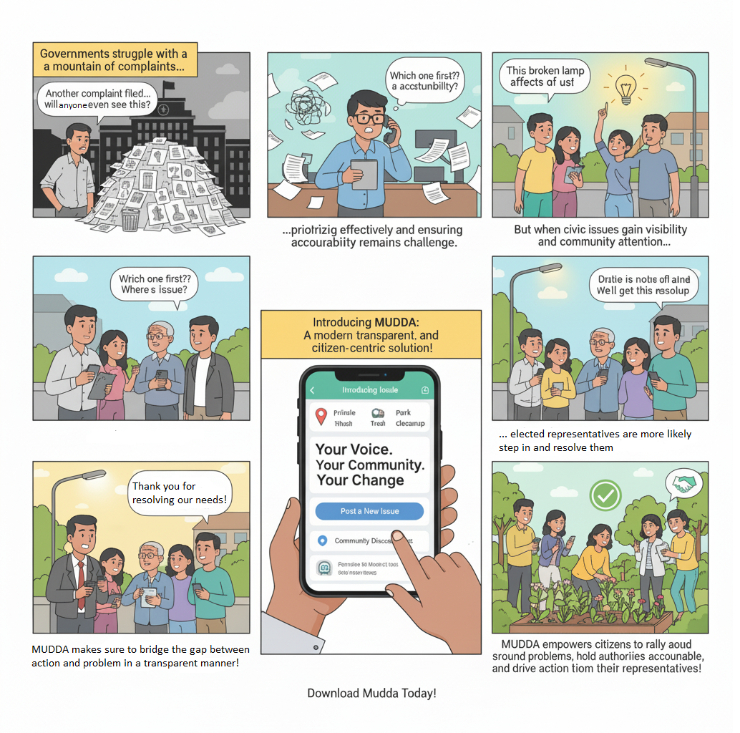

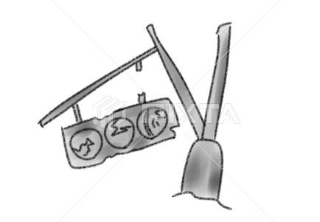
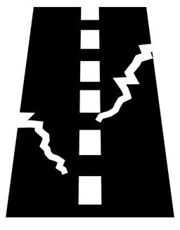


Description of the Broad Topic

Slide 4






Problem Statement
Mudda is a social-media inspired platform that empowers citizens to raise and track civic issues transparently. It bridges the gap between the public and government authorities by ensuring accountability, real-time updates, and community engagement.
Solutions offered
Problems citizens face
A single centralized mobile app to raise and manage civic issues.
Social-media inspired design → easy adoption and engagement.
Real-time status updates on each complaint.
Geo-tagging & maps for accurate location-based issue reporting.
Upload photos/videos as visual evidence.
Citizens can upvote, like, or comment on issues → community validation.
Automated categorization & duplicate detection using AI.
Clear responsibility mapping shows which authority is handling the issue.
Dashboards for government → efficient monitoring & prioritization.
Transparent communication loop between citizens and officials.
Notifications for citizens → timely updates on resolution.
Citizens face recurring civic issues: potholes, garbage, broken streetlights, water shortages.
Existing complaint methods (govt. offices, helplines, portals) are slow, inefficient, and fragmented.
No real-time tracking of complaint status.
Lack of accountability from authorities.
Citizens cannot see if others in their area face the same problem → low community visibility.
No way to validate or prove complaints without evidence (e.g., photos).
Data and administration for decision-making is unstructured and underutilized.
Government struggles with prioritization and resource allocation.
Citizens don’t know which department/authority is responsible.
Administration overhead of the government bodies are unable to scale and keep up efficiently for the rising civic issues.

Slide 5






Objectives
Real-Time Tracking
Community Engagement
Location-Based Services
Citizens can see the live status of their reported issues and identify the responsible government authority, promoting accountability.
The app allows users to interact with existing issues, increasing public awareness and creating collective pressure for solutions.
Geotagging automatically captures the exact location of each issue on a map, enabling officials to quickly pinpoint and address problems.
Efficient Government Management
Simplify Issue Resolving
Visual Evidence
Users can report problems like potholes or broken lights with just a few taps, without needing to know complex official procedures.
Users can upload photos to provide clear visual proof of the issue, which helps officials understand the problem better.
A centralized dashboard helps officials manage, prioritize, and resolve issues with structured, location-tagged data.

Slide 6







Feasibility Study
OPERATIONAL FEASIBILITY
User-Friendly UI: Simple app design for citizens with minimal learning curve.
Government Portals: Role-based dashboards for officials to manage and prioritize issues.
Transparency: Citizens can track complaint status in real time.
Notifications & Alerts: Push notifications for updates, reminders, and status changes.
Community Engagement: Social media-like interactions (likes, comments, upvotes).Cross-Department Integration: Single centralized platform → reduces fragmentation.
TECHNICAL FEASIBILITY
Frontend: Flutter for cross-platform mobile app (Android + iOS).
Backend: Spring Boot for scalable REST APIs.
Databases: PostgreSQL (structured data) + MongoDB (unstructured data like images & metadata).
AI/ML Integration: Pre-trained models + Smart Custom Agentic AI Workflow for automatic issue categorization & duplicate detection.
Features: Location-based tagging (POSTGIS), media uploads (AWS S3), notifications, dashboards.
Hosting & Infrastructure: Cloud-based deployment (scalable microservices).
ECONOMIC FEASIBILITY
Open-Source Stack: Flutter, Spring Boot, PostgreSQL, etc.
Cloud Services: Pay-as-you-go model → reduces upfront infra costs.
Student-led Development: Minimizes initial manpower costs.
Low Maintenance Costs: Scalable design ensures reduced long-term overhead.
Efficiency Gains: Cuts down manual paperwork & admin overhead for government.
Long-Term ROI: Data-driven governance → better resource allocation, improved trust, reduced duplication of work.

Slide 7



Existing Solutions/Literature Review
National Government Platforms: Platforms like Swachhata-MoHUA focus on specific issues like sanitation , while others like UMANG act as umbrella portals for multiple government services but aren't tailored for local civic complaints.
State and City-Level Apps: Applications such as PuraSeva (Andhra Pradesh) and MCD311 (Delhi) offer comprehensive but geographically limited grievance systems. Others are even more niche, targeting single utilities like water supply (BWSSB MyComplaint) or specific problems like streetlights (GNIDA Street Light App).
Community-Led Platforms: Citizen-driven initiatives like ICRF and NetaG attempt to connect citizens with officials or politicians. However, they often lack official government integration, and their success depends on political goodwill or media pressure.

Slide 8
GAPS in existing solution/literature review
1. Absence of Smart Intelligence: Current apps do not use AI or smart technology. This results in challenges like spam, duplicate complaints, and an inability for officials to prioritize issues based on severity or public sentiment.
2. Poor Transparency and Trust: Citizens are often unaware of their complaint status and distrust the process due to a lack of transparency and poor follow-up enforcement. Mudda's proposed use of verified government accounts directly addresses this trust deficit.
3. Lack of Community Engagement: Most platforms are purely transactional "complaint boxes". They lack a social layer for citizens to discuss, upvote, or amplify issues, leading to low adoption and engagement.
4. Limited Scope and Scalability: Existing solutions are often restricted to a single city, state, or specific issue (e.g., sanitation, water). There is no single platform designed for nationwide scalability that maintains hyperlocal relevance.

Slide 9
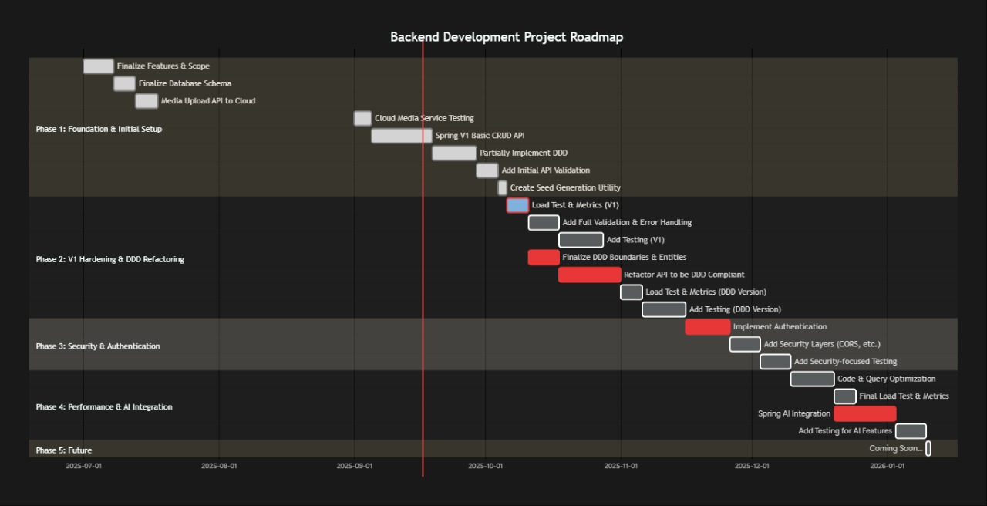
GANTT Chart: Backend

Slide 10
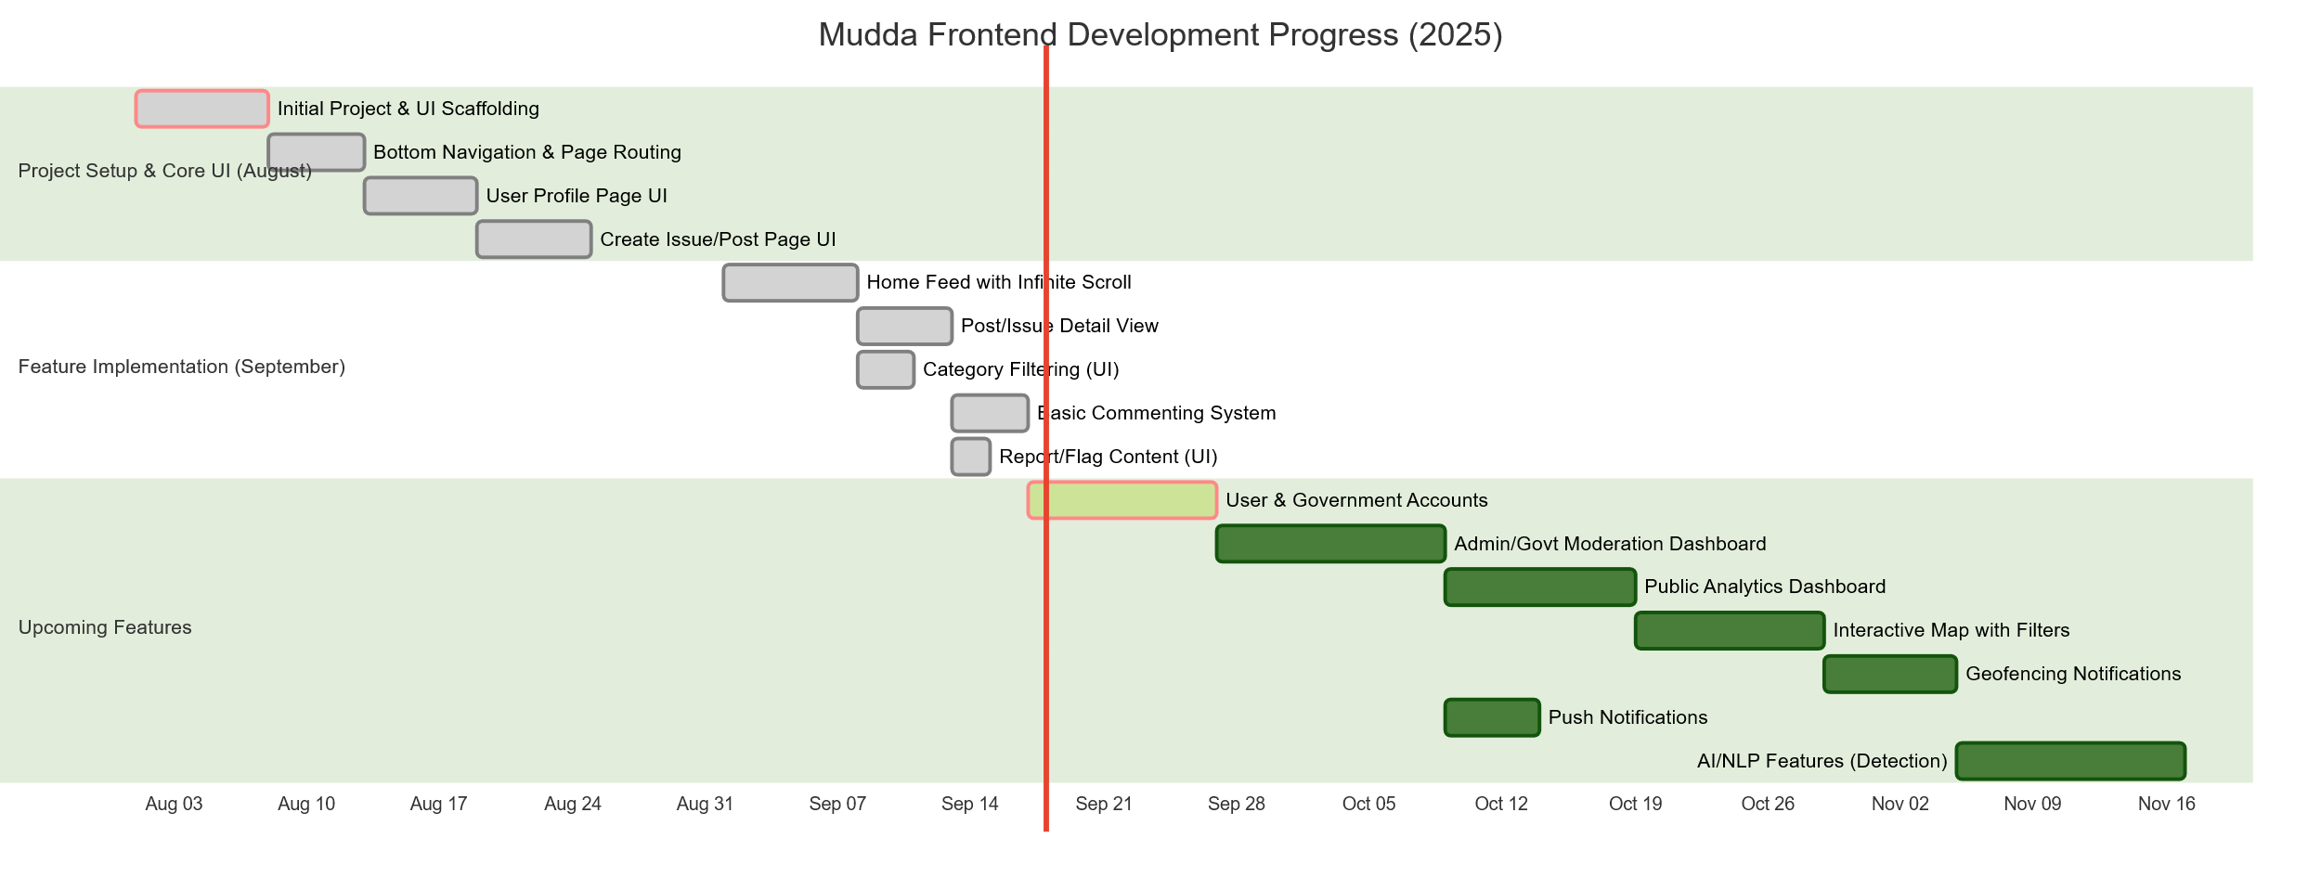
GANTT Chart: Frontend (Mobile + Web Dashboard)

Slide 11
Responsibility Chart
Saumil Kulshreshtha (22CSU158)
Shivesh Kumar Dhiman (22CSU164)
• Designing and developing the user interface of the mobile application using Flutter. • Ensuring a user-friendly and intuitive experience for issue posting and tracking.
• Assisting in frontend development tasks • Managing application deployment pipelines (CI/CD) • Ensuring proper cloud resource allocation, scalability, and reliability
Shubh Pundir (22CSU165)
Vikas Kumar (22CSU190)
• Implementing AI functionalities (e.g., automatic issue categorization, duplicate detection). • Developing backend APIs using Spring Boot for issue management.
Created Agentic AI Workflow microservice to reduce administration overhead by government offices for plan creation, workflow orchestration of the APIs/microservices
• Leading the backend development team • Designing and implementing the database schema using PostgreSQL and MongoDB
• Ensuring scalability and performance of the backend system

Slide 12
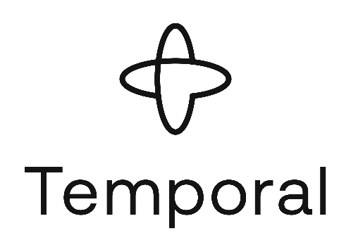

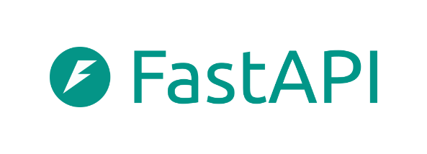





Tools/Platforms Used
Frontend Development: Flutter for cross platform mobile first application + NextJS for landing page and web based agentic AI workflow dashboard. Landing Page Link. Mobile App GitHub Link.
Backend Development: Spring Boot for Java based, production-ready backend for social media. Spring Backend GitHub Link.
Agentic AI: Python FastAPI based agentic AI workflow backend using Gemini + Temporal.io for workflow orchestration. Agentic AI Workflow GitHub Link.
AI/ML models: Fine-tuned hugging face and open-sourced models for post duplication, Image Caption Generation, AQI Assessment, Hate Speech Generation, etc.
Cloud Deployment + DevOps : AWS Beanstalk for hosting backend microservices and using gRPC for cross API communication. Vercel for frontend deployment of AI Workflow and Landing Page. Both above powered by GitHub actions and CI/CD tools such as Jenkins.
Database: Free Tier of hosted PostgreSQL NeonDB server and connected via DBeaver.

Slide 13
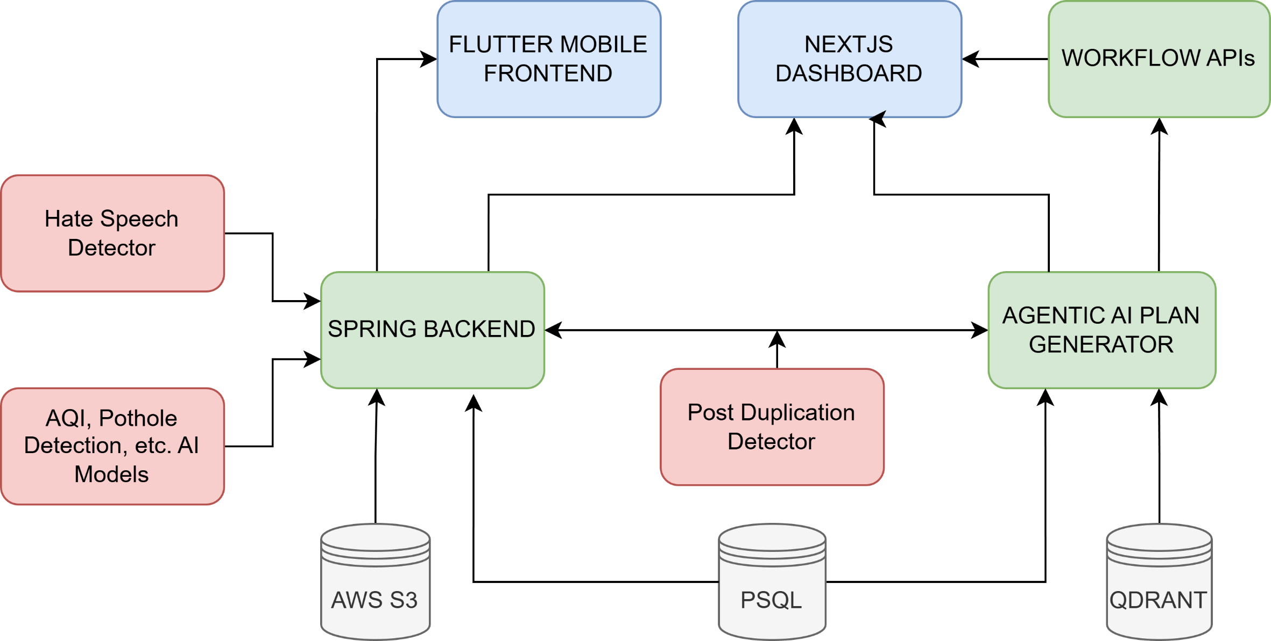
Design Methodology/Research Methodology

Slide 14




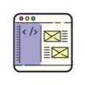
Outcome
SPRING BACKEND
FLUTTER MOBILE APP
High-performance microservice backend deployed on AWS.
Supports thousands of concurrent users with auto-scaling and secure prod ready API management.
Real-time data sync for issues, user actions, and AI workflows.
Cross-platform citizen app for posting issues, discussions, upvoting, and tracking resolutions.
Smooth, fast UI with native-like performance across Android and iOS.
Instant notifications, location tagging, media upload, and live status tr
acking.
NLP + CV Models
Deep learning pipelines for:
Duplicate issue detection
Hate speech & abusive language detection
Topic classification & sentiment analysis
Fine Tuned BERT for issue and component classification
Reduces moderator load by >60% through automated pre-filtering.
AI WORKFLOW ENGINE
NEXT.JS WEBSITE
Automatically analyses incoming issues and triggers decision workflows.
Mimics admin decision patterns using rule-based + LLM-based reasoning.
Assigns priority, detects duplicates, and routes issues to correct administrative buckets.
Enables “zero-touch” issue resolution for common cases.
Hosted Web-based command center for reviewing issues, verifying duplicates, and issuing resolutions.
Real-time insights, analytics charts, workflow monitoring, and case-handling tools.
Secure role-based access for moderators, admins, and audit teams.

Slide 15
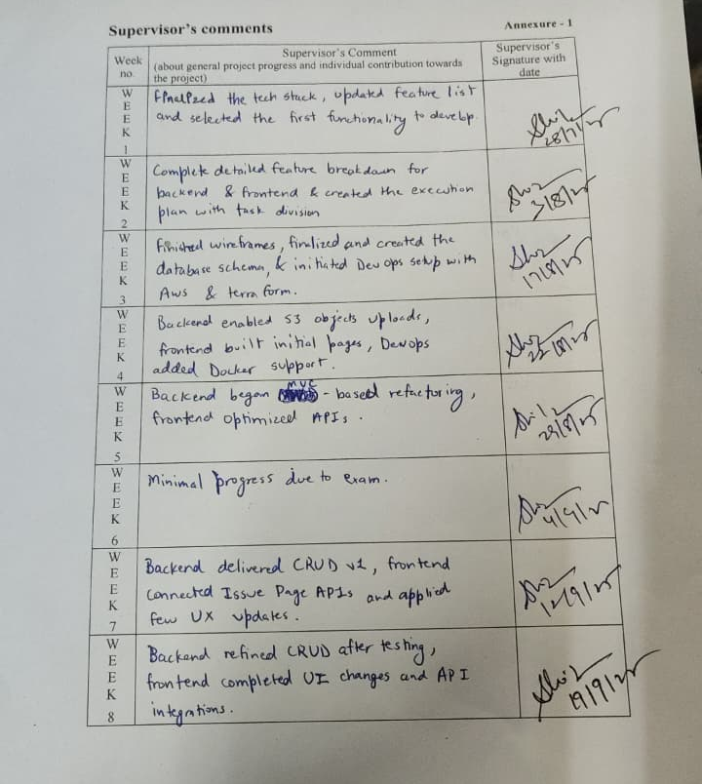
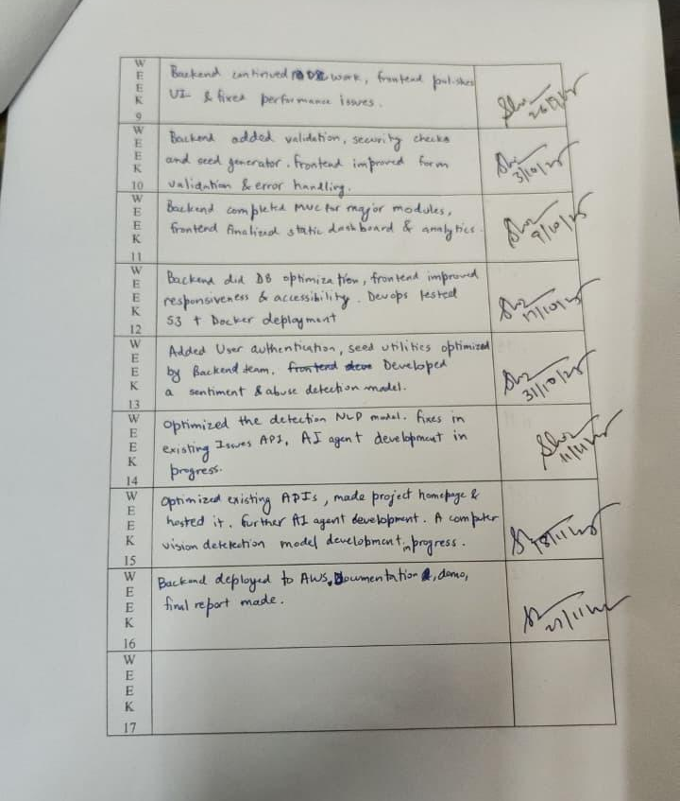
Comments by Supervisor

